Slide 1
Critical Thinking Activity: Events leading to secession
Choose 5 of the following events and put them in a ranked list based on their importance in causing the Southern states to secede from the Union in 1860-1861.
For each event:
give a short summary of what happened
the significance of the event, and most importantly
an explanation of why they placed the event in the position that you did on your ranked list.
Compromise of 1850
publication of Uncle Tom's Cabin by Harriet Beecher Stowe
Kansas-Nebraska Act
events in "Bleeding Kansas"
decision in the Dred Scott case
John Brown's raid on Harper's Ferry
the election of Abraham Lincoln

Slide 2
Civil War

Slide 3
Crittenden Plan
Discussion of proslavery amendments in Congress to appease south
Crittenden Plan: extend the Missouri Compromise line to the Pacific Ocean
Buchanan takes no action to stop secession
Lincoln rejects
Does not think it will end secession
Viewed as going against Republican principles

Slide 4
Sectionalism

Slide 5
Resources: North versus South

Slide 6
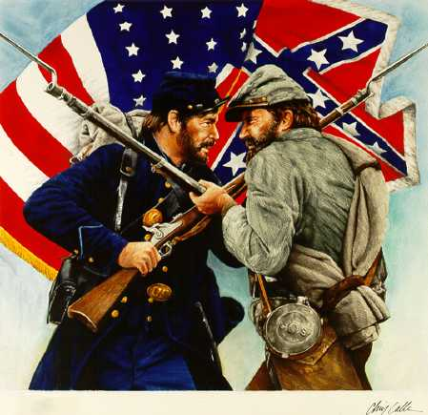

Slide 7
Causes of the Civil War
State’s Rights
Slavery
Sectionalism
Differing Economies and views on Tariffs
Southerners Believe “state first and their country second”
Lincoln was committed to preserving the Union(country)

Slide 8
1860 Election
Republican Abraham Lincoln was elected president
South Carolina is the 1st state to secede from the Union.
Mississippi, Florida, Alabama, Georgia, Louisiana, and then Texas follow
Formed a new country called the Confederate States of America (the “Confederacy”)
CSA elects Jefferson Davis President

Slide 9
Legends of the Civil War
Union (North)
Confederacy (South)
Abraham Lincoln
President
Winfield Scott, George McClellan, Ulysses S. Grant
Commander of Union Forces
William T. Sherman
General
Jefferson Davis
President
Robert E. Lee
Commander of Confederate Troops
Thomas “Stonewall” Jackson
General

Slide 10
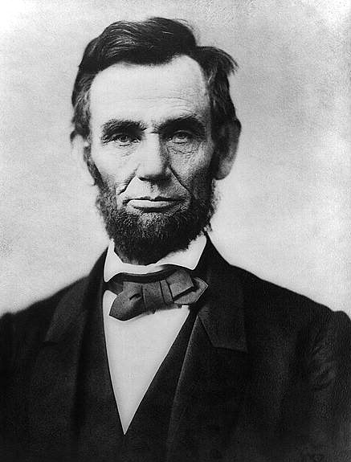
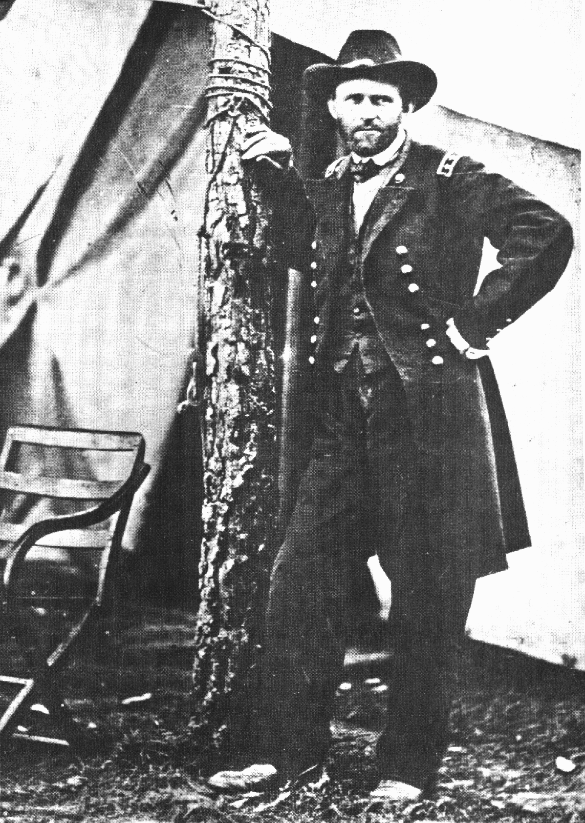
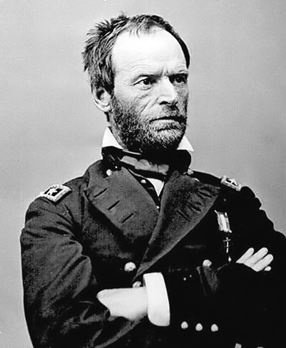
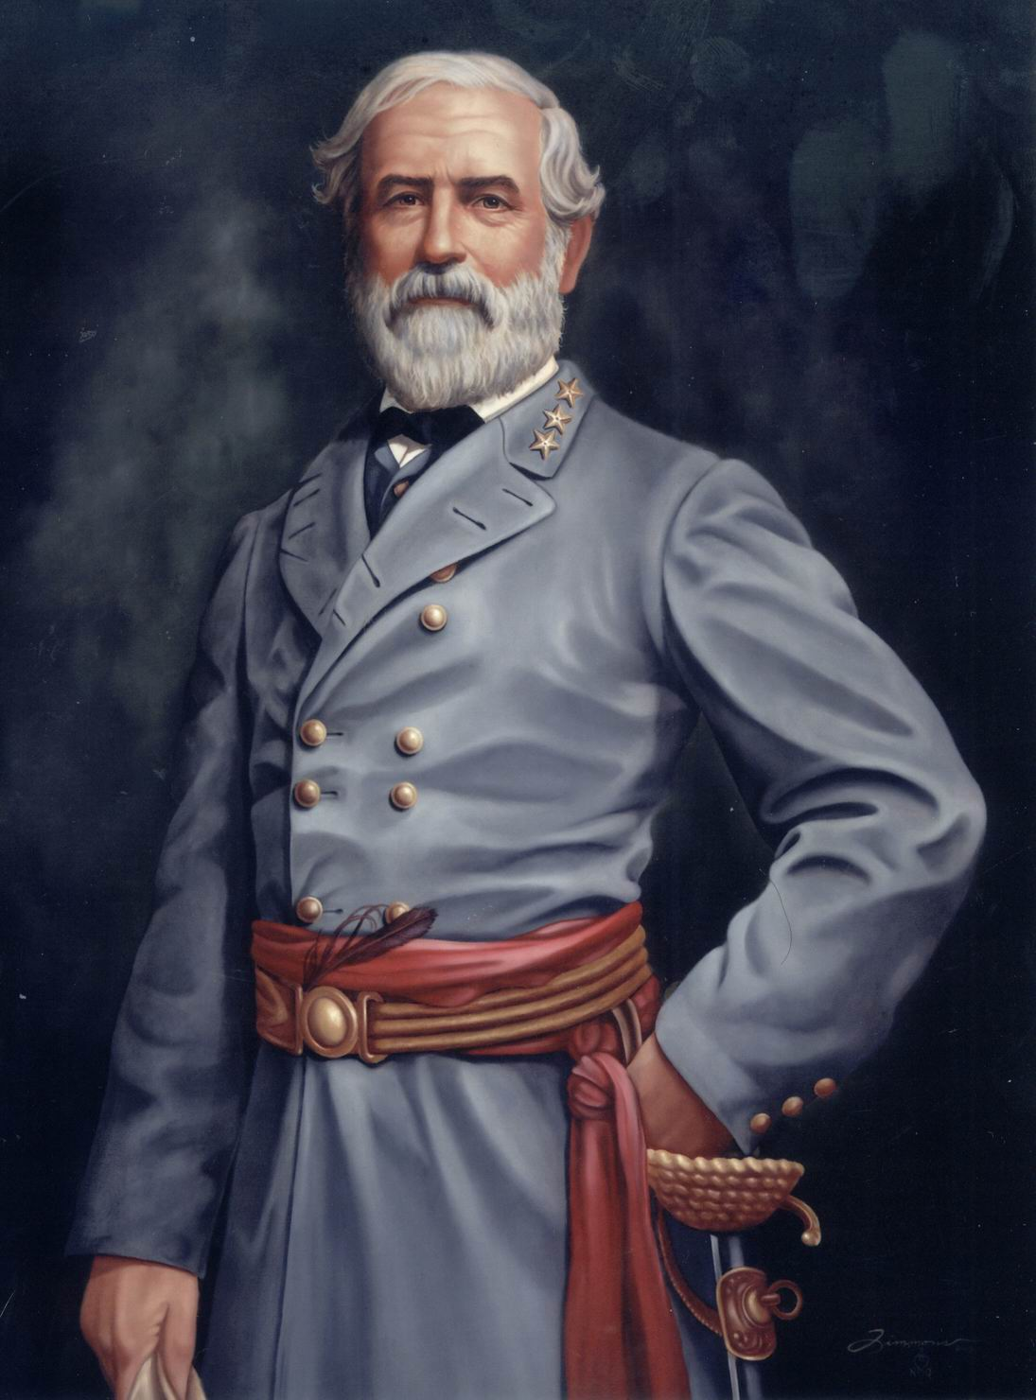
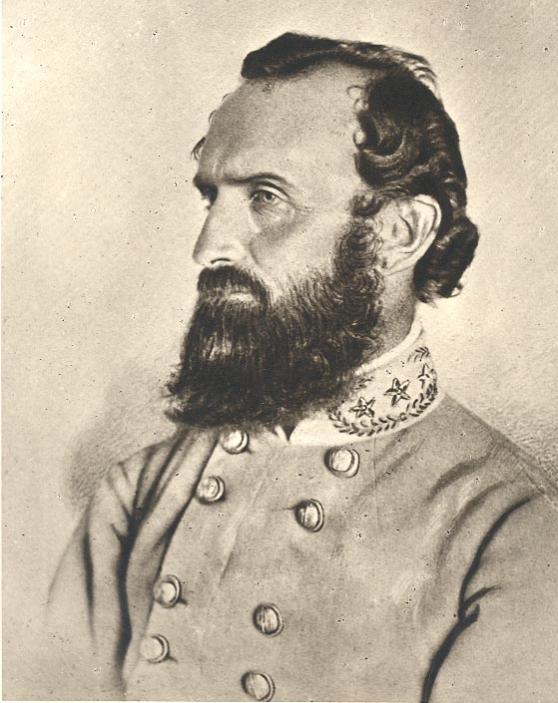
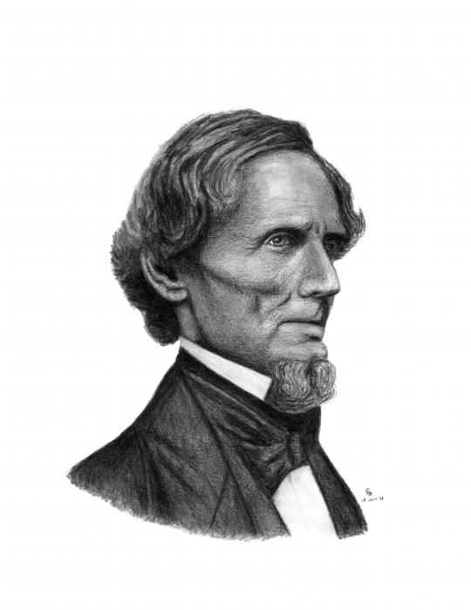

Slide 11
Bellwork:
What were the Union strategies for winning the Civil War?

Slide 12
Fort Sumter
Located in South Carolina
Confederate forces attack Fort Sumter (occupied by U.S. forces)
First shots are fired
After 2 days of fighting the Confederate militia forced the fort to surrender.
The Civil War becomes a military conflict

Slide 13
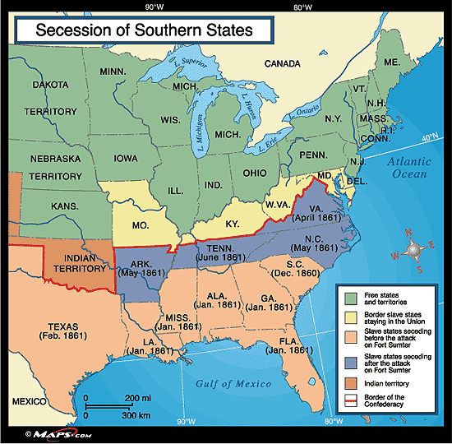

Slide 14
Union Strategies
The Union forces divided into two major armies.
The plan:
to fight in the east in Virginia
to fight in the west to control the major port and rivers.
The eastern army sought to capture Richmond, Virginia, the new Confederate capital.
The western army aimed at taking the Tennessee and Mississippi rivers and the important port of New Orleans.

Slide 15
1st Battle of Bull Run
July 1861
The First Battle of Bull Run (Manassas) was the first major land-based confrontation
Located just miles from Washington D.C.
The Union army commander in Washington was under great pressure to begin campaigning before his men’s 90-day enlistments expired. He went to battle even though he felt his men weren’t adequately trained yet.
It was a stunning Confederate victory & ended northern hopes of a quick end to the war.

Slide 16
Antietam
Confederate General Robert E. Lee took his Army of Northern Virginia to Maryland in 1862 to gain supplies, influence elections, and bring the war to the North.
The battle resulted in 6,000 killed and 17,000 wounded. It was the bloodiest one-day battle of all U.S. wars.
A Georgia brigade under Robert Toombs, who was wounded in the battle, held back Union troops trying to cross a key bridge over Antietam Creek.
After the Battle of Antietam, Lincoln issued the Emancipation Proclamation, the act that freed the slaves.

Slide 17
The Emancipation Proclamation
The document written by Abraham Lincoln stated that on January 1, 1863, slaves in the areas still in rebellion would be free.
As the Union Army conquered areas of the South, slaves became free.
As a result of the proclamation, Missouri and Maryland, though not in rebellion, freed their slaves.
Congress and Lincoln supported a permanent amendment to the U.S. Constitution that would make slavery unconstitutional.

Slide 18
Vicksburg and Gettysburg
General Lee decided to invade Pennsylvania in 1863, hoping that a Confederate victory in the North would make the Union less willing to fight and negatively affect Northern elections.
Lee hoped the British and French would also recognize the Confederacy as an independent nation.
The July 1-3 battle at Gettysburg was a loss for the Confederacy and proved to be a turning point in the war for the Union. Vicksburg, Mississippi fell to the Union on July 4, giving the Union control of the Mississippi.
All hopes of foreign help ended and all future battles were fought in the South.

Slide 19
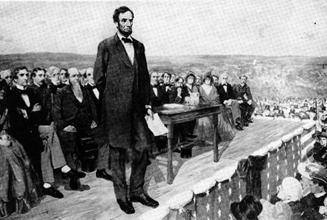
The Battle of Gettysburg
Gettysburg, Pennsylvania
July 1-3
Union victory
Turned the tide of the war in favor of the Union.
Lincoln’s speech “The Gettysburg Address” inspired the Union to keep fighting

Slide 20
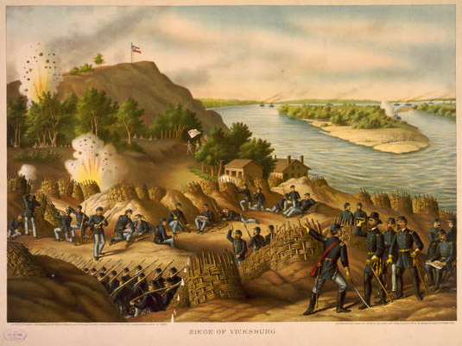
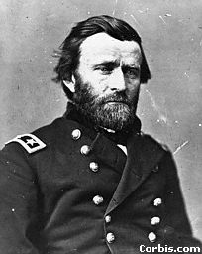
Vicksburg
The Battle of Vicksburg
July 4th
Union was lead by Ulysses S. Grant.
This battle cut the Confederacy in two using a blockade and taking control over the Mississippi River.

Slide 21
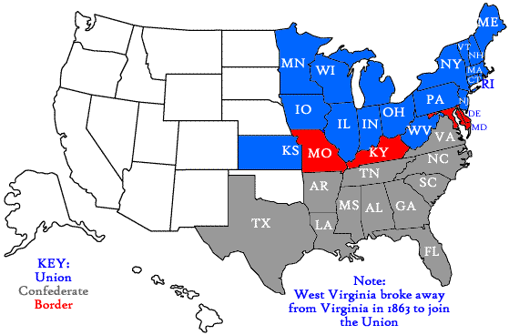
Gettysburg
Antietam
Bull Run
Fort Sumter
Vicksburg

Slide 22
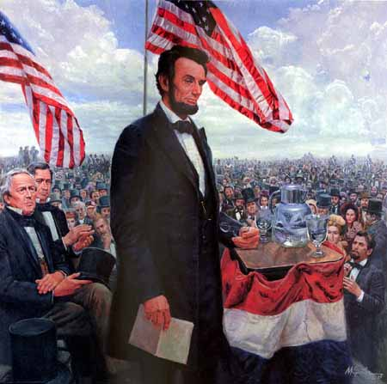
Gettysburg Address
November 16, 1863
dedication of a military cemetery at the Gettysburg battlefield four months after the battle occurred
Speech about our great country and how we needed to finish the war
Americans respond jubilantly across the country

Slide 23
Gettysburg Address
Four score and seven years ago our fathers brought forth on this continent, a new nation, conceived in Liberty, and dedicated to the proposition that all men are created equal.
Now we are engaged in a great civil war, testing whether that nation, or any nation so conceived and so dedicated, can long endure. We are met on a great battle-field of that war. We have come to dedicate a portion of that field, as a final resting place for those who here gave their lives that that nation might live. It is altogether fitting and proper that we should do this.
But, in a larger sense, we can not dedicate -- we can not consecrate -- we can not hallow -- this ground. The brave men, living and dead, who struggled here, have consecrated it, far above our poor power to add or detract. The world will little note, nor long remember what we say here, but it can never forget what they did here. It is for us the living, rather, to be dedicated here to the unfinished work which they who fought here have thus far so nobly advanced. It is rather for us to be here dedicated to the great task remaining before us -- that from these honored dead we take increased devotion to that cause for which they gave the last full measure of devotion -- that we here highly resolve that these dead shall not have died in vain -- that this nation, under God, shall have a new birth of freedom -- and that government of the people, by the people, for the people, shall not perish from the earth.
Abraham Lincoln November 19, 1863

Slide 24
The War Comes to Georgia
By 1863, many Georgians were disheartened, as the death rate of soldiers grew due to battle and disease.
Poor and middle class Georgians were drafted into the war. Wealthy families paid people to go to war as their substitutes.
Inflation and shortages of goods hurt morale on the home front.
In 1864, the Union army under General William Tecumseh Sherman entered north Georgia with plans to take Atlanta and then Savannah.
The battles and Sherman’s march through Georgia left the state in ruins by the winter of 1864-65.

Slide 25
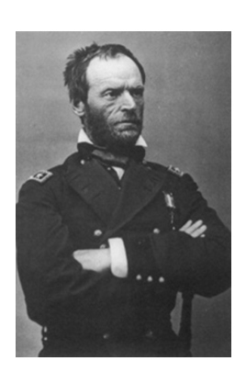
General Sherman

Slide 26
The Campaign for Atlanta
Sherman's army started out with 112,000 men
Sherman's immediate goal was to capture Atlanta
The Confederate General Johnston only had 60,000 men
General Joseph Johnston’s Confederates fought a series of defensive battles as Sherman’s army moved south toward Atlanta.
During the summer the first battles were fought in Dalton, Resaca, and New Hope
Johnston low on supplies had to retreat but burned down bridges and blocked roads

Slide 27
The Campaign for Atlanta
It caused Sherman's march to slow.
In June, Sherman's army attacked Kennesaw Mountain.
The CSA won at Kennesaw Mountain.
Jefferson Davis replaced General Johnston with General John B. Hood
In July, Hood fought against Sherman and lost 11,000 men in two days

Slide 28
Battle of Atlanta
General John Hood led the Confederates at the Battle of Atlanta, July 20-22. By early September, Sherman moved into Atlanta.
Atlanta was captured by the Union on Sept 2, 1864
Atlanta was set on fire November 15th
Lincoln was in danger of losing the 1864 election against Democratic Party platforms (principles) that opposed emancipation and sought peace with the South. Sherman’s capture of Atlanta helped Lincoln win reelection.

Slide 29
The Campaign for Atlanta
The strategy of "laying waste to the land" was in full force in Georgia by November 1864.
On November 16th Sherman began his March to the Sea

Slide 30
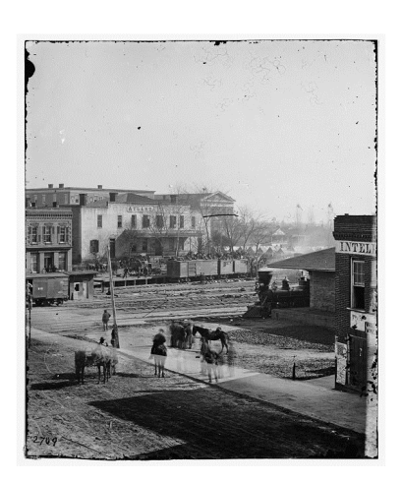
Soldiers on boxcars at Railroad Depot

Slide 31
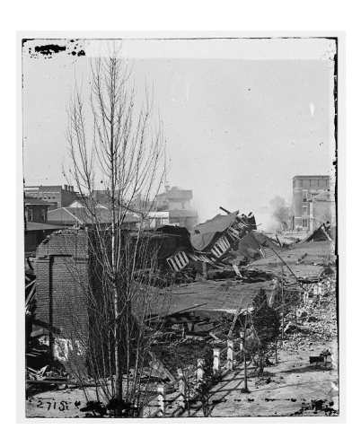
Ruins of Train Depot

Slide 32
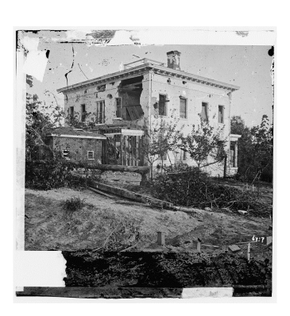
A Shell Damaged Home

Slide 33
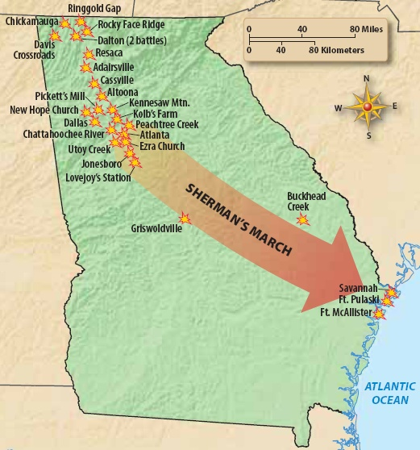

Slide 34
Sherman’s “March to the Sea”
During this march 60,000 soldiers cut a path 60 miles wide on a 300 mile trip from Atlanta to Savannah.
Savannah was captured on December 25th 1864
Sherman gave the city of Savannah and 25,000 bales of cotton to President Lincoln as a Christmas Present

Slide 35
Lincoln’s Second Inaugural Address
March 4, 1865
Lincoln speaks to the nation about the war and putting the country back together in his 2nd term
Lincoln expressed sorrow that the states had not been able to resolve their differences peacefully
Urged Americans not to seek revenge on slaveholders and their supporters/military
Addressed the major issues in the country at the time

Slide 36
The War’s End
In Virginia, Confederate General Robert E. Lee surrendered his army on April 9, 1865. Union General Ulysses Grant allowed Lee’s men to leave for home to plant crops.
All remaining Confederate armies surrendered by May 1865. More than 620,000 Union and Confederate troops died in the war. Many thousands more were wounded.

Slide 37
