Slide 1
Antebellum Compromises through Election of 1860

Slide 2
Missouri Compromise (1820)
Balance between Slave and free states in Congress is super important to politicians
Missouri Compromise (1820)
Maine is admitted as free state and Missouri is admitted as a slave state
LA Territory is split into slave and free land
North of 36˚ 30’ N = Free land
South of 36˚ 30’ N = Slave land
Issue of slavery is not fully dealt with and will lead to more conflicts (CIVIL WAR)

Slide 3
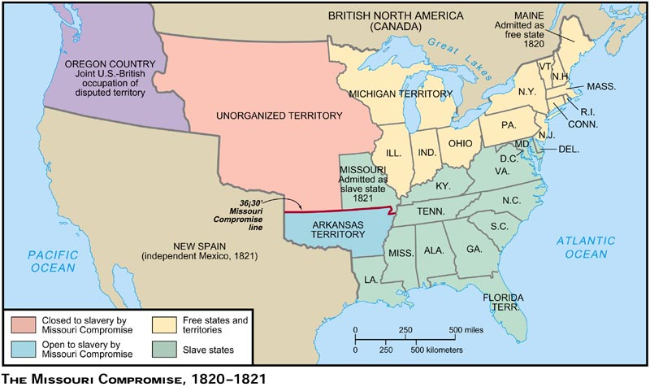

Slide 4
Manifest Destiny
Americans headed west for multiple reasons
Escape religious persecution
Find new economic opportunities
Claim land for farming, ranching, mining
Create harbors on the Pacific Ocean
Avoid bankruptcy and creditors

Slide 5
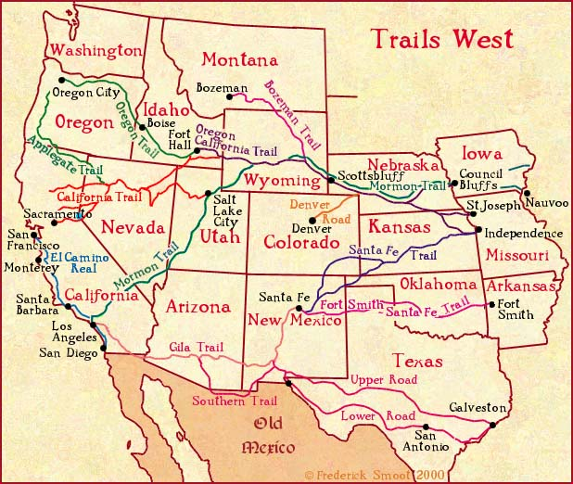

Slide 6
Texas
Mexico gets independence from Spain (1821)
Americans move to what is now Texas by the thousands
Americans in Mexico (Texas) want more rights and control of the gov’t
War breaks out in 1835 for Texas Independence
Sam Houston leads the Americans, while Santa Anna leads the Spanish
Battle of the Alamo is the turning point for the Americans
Republic of Texas is established in 1836 with Sam Houston as President
Texas is annexed(became a state) in 1845.

Slide 7
Texas
President Polk makes sure that Texas becomes a state, which leads to controversy with Mexico
Debate over annexation of Texas is heated because of slavery
US and Mexico continue to wage war over the south West and California
War Ends, with US as the Victor
Treaty of Guadalupe Hidalgo
Texas, New Mexico, & California
Gadsden Purchase
Completed the lower 48 States borders

Slide 8
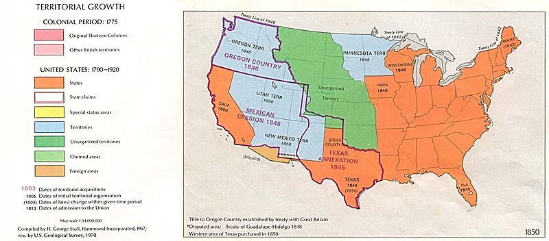

Slide 9
Wilmot Proviso
During the Mexican-American War, Congress debated whether slavery would be allowed in Territories gained from Mexico.
Wilmot Priviso - Proposed August 1846 by David Wilmont, a Democrat from Pennsylvania
He proposed that in any territory that the U.S. gained from Mexico “neither slavery nor involuntary servitude shall ever exist.”
Southerners were outraged
It passed in the House of Representatives but the Senate refused to vote on it. → The debate over slavery would continue.

Slide 10
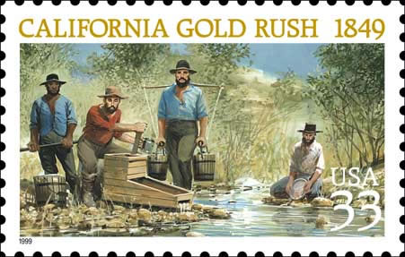
1849 Gold Rush

Slide 11
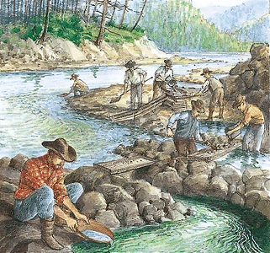

Slide 12
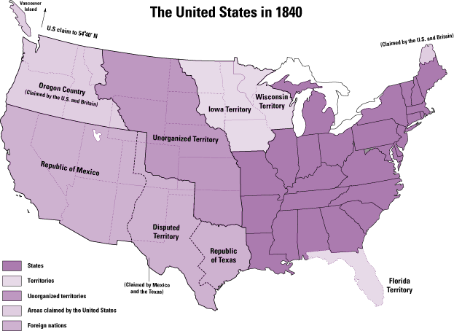

Slide 13
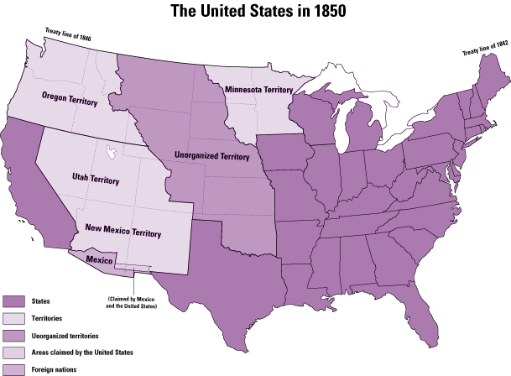

Slide 14
Sectionalism and States Rights (1850)
Sectionalism: the north and the south are growing apart rapidly both economically and politically
Debate over slavery is at an all time high
Agrarian society vs. the industrial revolution
Failure of the Wilmot Proviso led to even greater conflict over slavery in Congress and among American citizens
1850 California becomes a state after a population explosion due to the gold rush

Slide 15
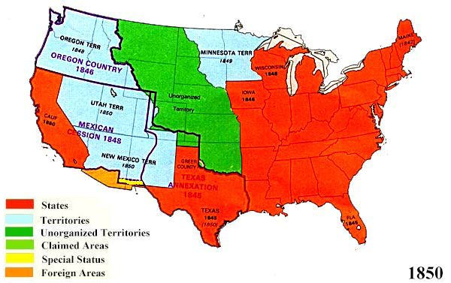

Slide 16
Important Terms to know!
Southern states begin to champion nullification, secession, and states rights
Nullification- states refusal to recognize or obey an act of Congress
Secession- formal withdrawal of a state from the Union (leave the country)
States Rights- federal gov’t should not meddle with state/local gov’t affairs/business

Slide 17
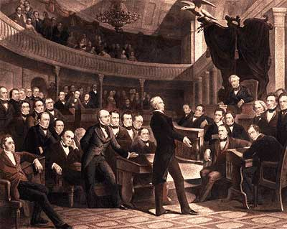

Slide 18
Compromise of 1850
California admitted as a free state
Utah/New Mexico get popular Sovereignty
Popular Sovereignty- citizens vote to decide on issues relating to gov’t
Fugitive Slave Law enacted
Required northern states to forcibly return escaped slaves to their owners in the South.
Many northern states refused to obey by it.

Slide 19
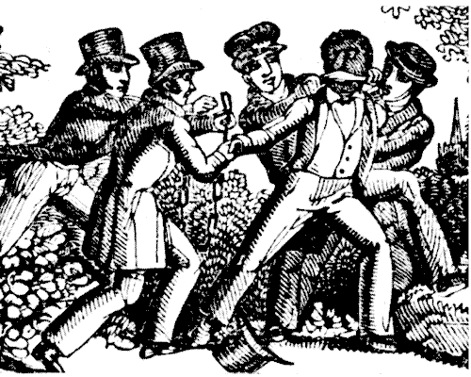
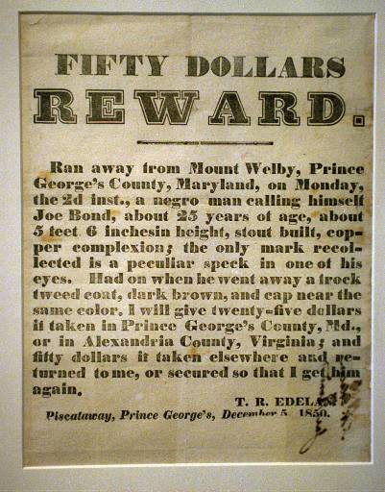
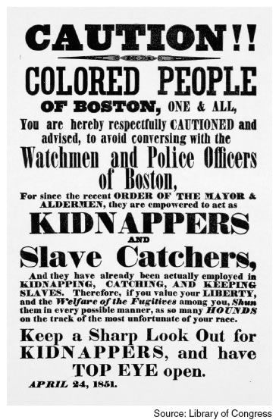
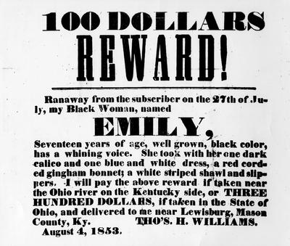
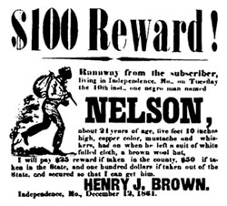
Fugitive Slave Act

Slide 20
Underground Railroad
Secret network of people(conductors), houses, and barns(stations) that helped runaway slaves find their ways to the northern states and freedom.
Harriett Tubman
Uncle Tom’s Cabin
Harriet Beecher Stowe’s novel caused the stirrings of abolition to grow across the country rapidly

Slide 21
Bleeding Kansas
Kansas-Nebraska Act 1854
Popular Sovereignty for Kansas and Nebraska
Settlers move west to vote for/against slavery
Violence erupts between settlers over the issue of slavery “Sack of Lawrence”
John Brown leads the Pottawatomie Massacre
They chopped off the hands of 5 proslavery men and then stabbed them in the stomach

Slide 22
Bleeding Kansas
Preston Brooks (Democrat) attacks Charles Sumner (Republican)
Sumner was a fiery abolitionist
Brooks took offense to the verbal attacks on his family and on South Carolina
Brooks attacked Sumner with his cane & Sumner was severely injured
Southerners considered him a hero and sent canes to him inscribed with “hit him again”
Northerners responded by saying “no way is left for the North, but to strike back, or be slaves.”

Slide 23
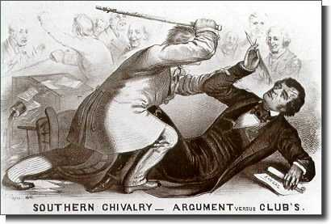
Brooks vs. Sumner

Slide 24
Understanding Check
Textbook pages 284-293
Analyze the visual on page 292 #’s 1 & 2
Answer Questions #2-7 on page 293
You need to write in complete sentences. You do not need to write the question.
Yes, I am collecting this!

Slide 25
Dred Scott Case
Dred Scott claimed he should be a free man because he had lived with his master in slave states and in free states.
Court rejected Scott’s claim, ruling that no African American––even if free––could ever be a U.S. citizen.
Dred Scott decision gave slavery the protection of the U.S. Constitution.

Slide 26
John Brown
Decided to fight slavery with violence and killing.
1856: Believing he was chosen by God to end slavery, Brown commanded family members and other abolitionists to attack proslavery settlers in Kansas, killing five men.
1859, he led a group of white and black men in a raid on the federal armory at Harpers Ferry, Virginia
Brown was captured by U.S. Marines led by U.S. Army Colonel Robert E. Lee. Eventually, Brown was convicted of treason against the state of Virginia and executed by hanging.

Slide 27
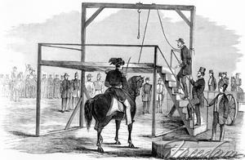
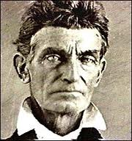

Slide 28
Review & Preview
American Vision Textbook:
Read pages 294 – 301.
Answer Questions 1-6
Read pages 302-307.
Answer Questions 1-6
Answers should be in complete sentences. Turn in at end of class period.

Slide 29
Antebellum Political Parties
Free Soil | Know Nothing Party | Whigs
Against the extension of slavery Pro-labor (workers) | AKA the American Party Nativism Anti-Immigration Anti-Catholic | Pro-business Divided on Slavery
Republicans | Democrats
Opposed expansion of slavery into new territories/states | States’ Rights Limited Government Divided on Slavery

Slide 30
Crumbling Political Parties
Caught in the sectional strife disrupting all national institutions, the Know Nothing American Party fell apart after 1856.
Antislavery Know-Nothings joined the Republican Party
Southern Know-Nothings joined the Democratic Party
In 1860, remnants of the Know-Nothing Party joined with the old Whigs to form the Constitutional Union Party.

Slide 31
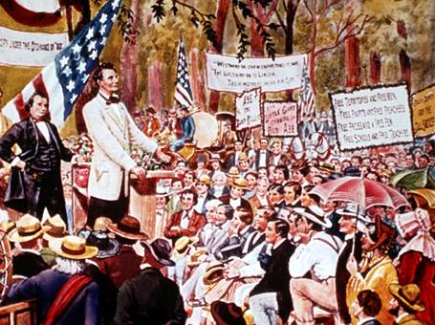
Lincoln Douglas Debates

Slide 32
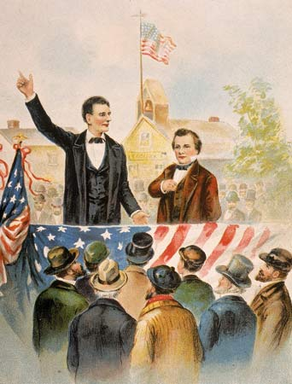
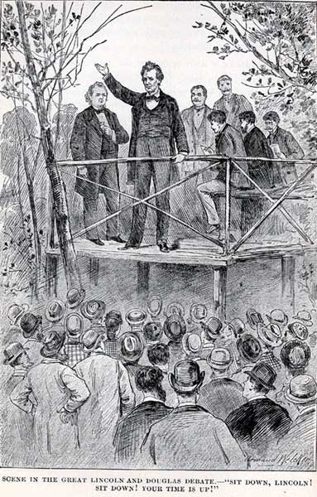

Slide 33
Candidates - 1860
Stephen Douglas (Northern Democratic Party)
Supported popular sovereignty
John Brekinridge (Southern Democratic Party)
Wanted an extension of slavery into western territory
Supported a federal slave code
Stressed state’s rights
John Bell (Constitutional Union Party)
Wanted to find some sort of compromise and preserve the Union
Abraham Lincoln (Republican Party)
Supported protective tariffs
A transcontinental railroad

Slide 34
Election of 1860
 |  | Popular vote in GA | Popular vote Nationally | Electoral College vote
Bell | Constitutional Union Party | 42,886 | 592,906 | 39
Brekinridge | Southern Democrat | 51,893 | 848,356 | 72
Douglas | Northern Democrat | 11,580 | 1,382,713 | 12
Lincoln | Republican | 0 | 1,865,593 | 180

Slide 35
Election of 1860 (cont.)
Republican Abraham Lincoln was elected president
South Carolina is the 1st state to secede from the Union.
Mississippi, Florida, Alabama, Georgia, Louisiana, and then Texas follow
Formed a new country called the Confederate States of America (the “Confederacy”)
CSA elects Jefferson Davis President

Slide 36
Election of 1860

Slide 37
Critical Thinking Activity: Events leading to secession
Choose 5 of the following events and put them in a ranked list based on their importance in causing the Southern states to secede from the Union in 1860-1861.
For each event:
give a short summary of what happened
the significance of the event, and most importantly
an explanation of why they placed the event in the position that you did on your ranked list.
Compromise of 1850
publication of Uncle Tom's Cabin by Harriet Beecher Stowe
Kansas-Nebraska Act
events in "Bleeding Kansas"
decision in the Dred Scott case
John Brown's raid on Harper's Ferry
the election of Abraham Lincoln

