Slide 1
Colonization

Slide 2
Essential Questions:
What key changes in Europe took place in the 15th & 16th centuries that allowed for overseas colonization?
How did European exploration in America impact native peoples?
What are the similarities & differences among the Spanish, French, & British patterns of colonization in America?

Slide 3
America Prior to the Arrival of Europeans

Slide 4
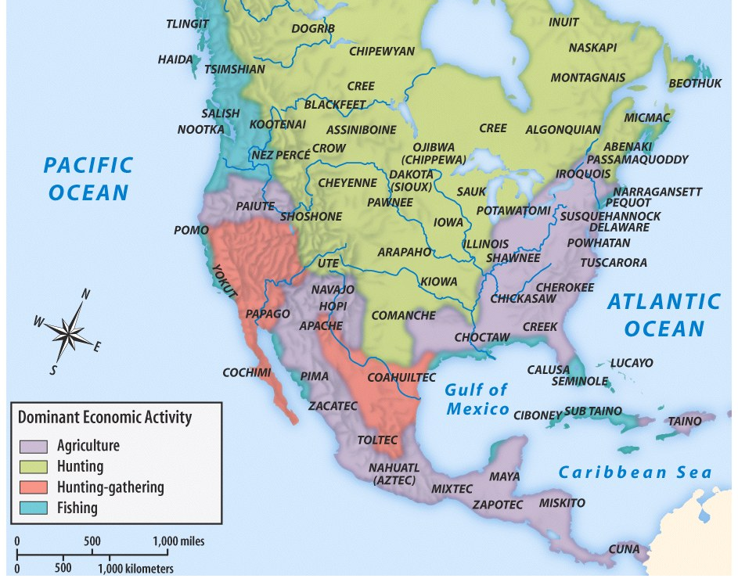

Slide 5
Locations of Major Indian Groups and Culture Areas in the 1600s
Notes:
4
4
4
04/06/98
4

Slide 6
The Old World Explores The New World

Slide 7
Essential Question:
What can you remember about the Age of Exploration from World History?

Slide 8
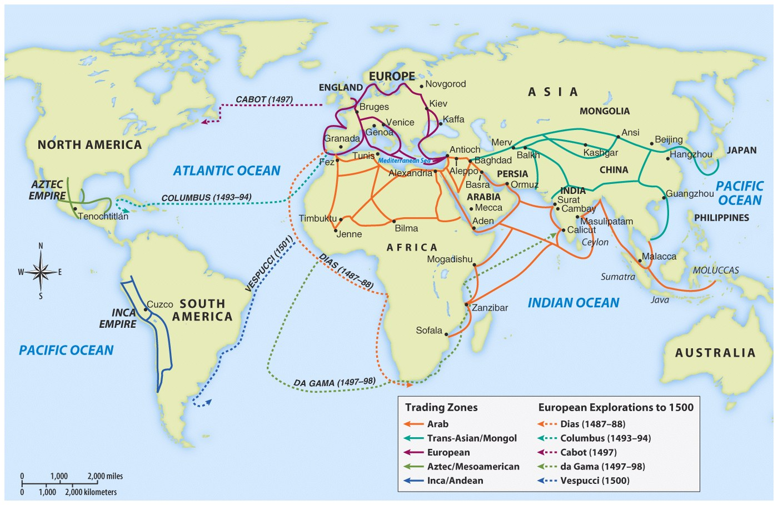
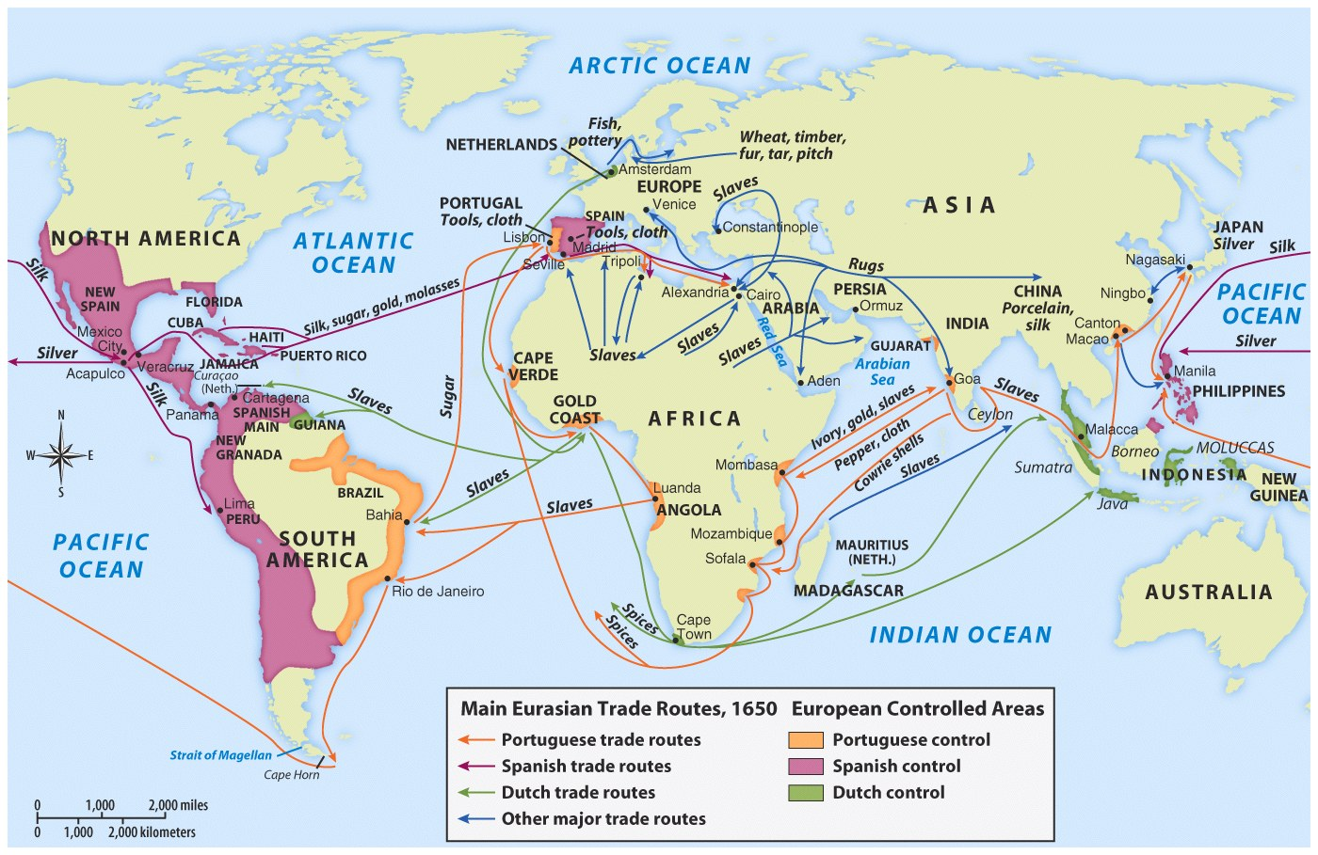
Voyages of European Exploration
Notes:
17
17
17
04/06/98
16

Slide 9
The Treaty of Tordesillas
Spain versus Portugal

Slide 10
The Treaty of Tordesillas (1494)
Spain secured its claim to Columbus’ discovery.
Spain staked claim to the new world.
Portugal was able to claim what is now known as Brazil.

Slide 11
Why did the “Age of Exploration” Occur?
What was the motivation of the individual explorer, conquistador, monarch?

Slide 12
Why did the “Age of Exploration” Occur?
What was the motivation of the individual explorer, conquistador, monarch?
Materialism, personal wealth
Glory, personal fame
Religion, conversion of the “heathens”
Nationalism, promoting the wealth and power of the nation
Scientific Curiosity

Slide 13
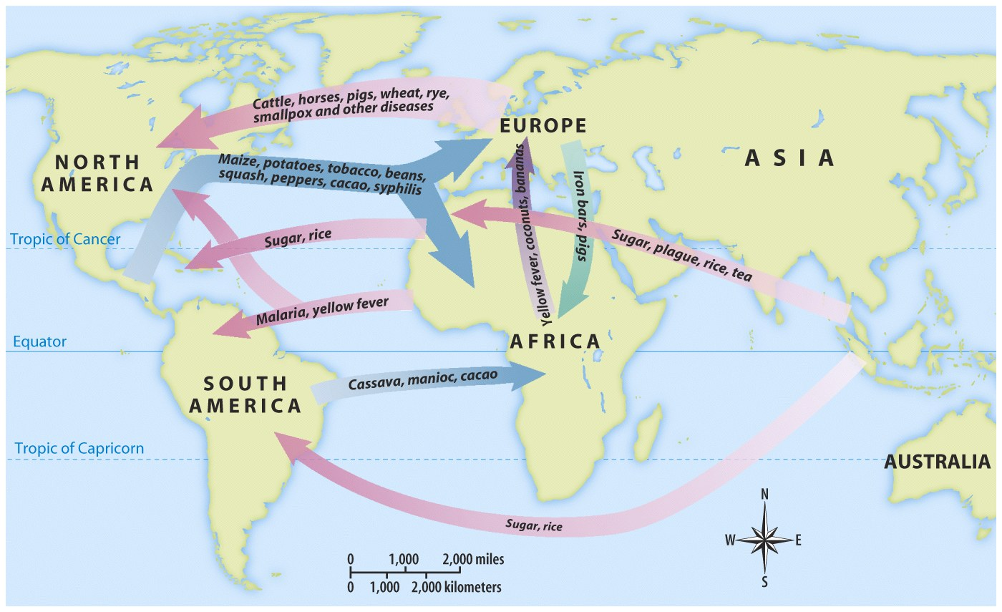
The Columbian Exchange

Slide 14
The arrival of Europeans led to the introduction of new products between Indians & Europeans called the Columbian Exchange
Notes:
Traffic across the Atlantic did not flow in just one direction, however.
Europeans introduced various livestock animals into the Americas. These
included horses, cattle, sheep, and pigs. Foods from Africa (including some that
originated in Asia) migrated west in European ships. They included bananas,
black-eyed peas, and yams. Grains introduced to the Americas included wheat,
rice, barley, and oats.
Some aspects of the Columbian Exchange had a tragic impact on many Native
Americans. Disease was just as much a part of the Columbian Exchange as
goods and food. The diseases Europeans brought with them, which included
smallpox and measles, led to the deaths of millions of Native Americans.

Slide 15
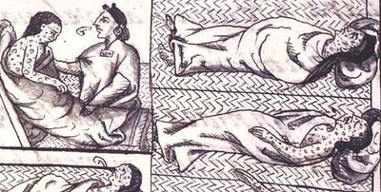
The introduction of potatoes & corn helped improve the diets & life expectancy of people throughout the world
The introduction of European diseases like smallpox & influenza killed as many as 90% of Native Americas
The introduction of European grains, horses, & cattle transformed many Indian cultures
Notes:
Traffic across the Atlantic did not flow in just one direction, however.
Europeans introduced various livestock animals into the Americas. These
included horses, cattle, sheep, and pigs. Foods from Africa (including some that
originated in Asia) migrated west in European ships. They included bananas,
black-eyed peas, and yams. Grains introduced to the Americas included wheat,
rice, barley, and oats.
Some aspects of the Columbian Exchange had a tragic impact on many Native
Americans. Disease was just as much a part of the Columbian Exchange as
goods and food. The diseases Europeans brought with them, which included
smallpox and measles, led to the deaths of millions of Native Americans.

Slide 16
How did the European Colonization affect Native Culture?
New Products
Especially Cutting tools, metal
Loss of Land
Loss of Liberty
Diminishing of Culture
Language
Customs
Religion

Slide 17
How did the European Colonization affect Native Culture?
Diminishing of Numbers
Extinction
Example - Taino
90% death rate
War
Disease
Small Pox
Whooping Cough
Measles
Chicken Pox, etc.

Slide 18
How did Native American Culture affect Old World civilizations?
Food
Corn
Tomatoes
Peppers
Chocolate
Pineapples
Sweet Potatoes
Potatoes ***
Health, Nutrition
Economic

Slide 19
How did Native American Culture affect Old World civilizations?
Recreation
Lacrosse
Tobacco
Chocolate
Government
Iroquois Confederacy
“Federalism” in the US Constitution

Slide 20
The Spanish Colonies in America

Slide 21
A World Transformed
Disease decimated 90% of Native American population
Notes:
7
7
7
04/06/98
7

Slide 22
Spanish Colonization
Its conquering of the Americas would allow Spain to become the most powerful empire in the world during the 16th Century
“We came here to serve God and King… and to get rich”
Known as “GOD, GLORY, & GOLD!”

Slide 23
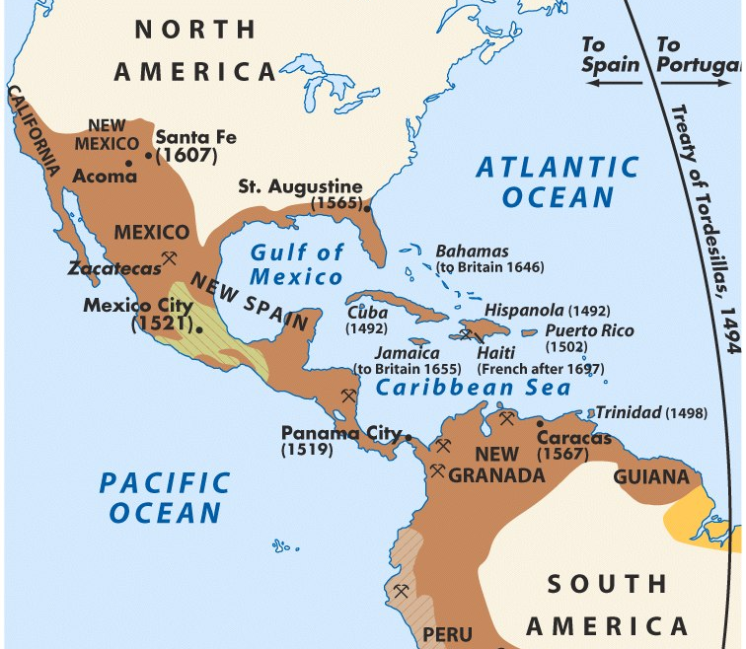
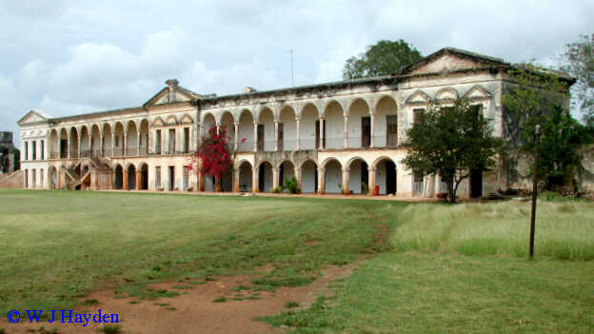
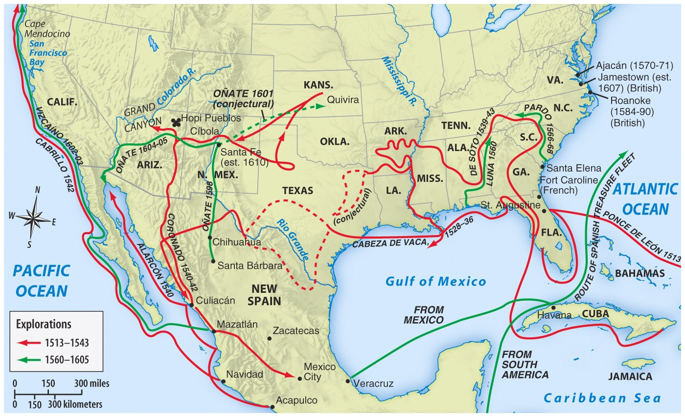
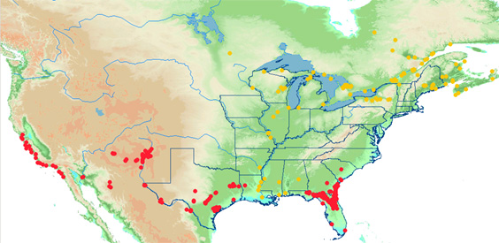
Spanish Conquests & Colonies
The Spanish used the encomienda system to create large cash crop plantations using Native American & African slave labor
Spanish missionaries focused heavily on converting Native Americans & establishing missions

Slide 24
Spanish Exploration of the US
Spain would never develop successful settlements (in terms of trade and power) in US territory → mainly due to its primary lust for gold and silver instead of developing centers of trade
Spanish Explorers:
Juan Ponce de Leon – explored Florida
Hernando de Soto – explored the Southeast US
Francisco Coronado – explored the Southwest US

Slide 25
Where did the Spanish settle?
Southwestern part of what is today the U.S.
Florida
Central & South America
St. Augustine – the oldest surviving settlement in the US, established in 1565 in Florida
Spanish missions would dot the Southwest US with some surviving today
Santa Fe was the 1st permanent seat of government in the US
By 1630 there were over 50 missions and 3,000 Spanish in the New Mexico territory

Slide 26
The French Colonies in America

Slide 27
The French Claim Canada
In 1608, Samuel de Champlain founded Quebec
French Empire eventually included:
St. Lawrence River
Great Lakes
Mississippi River Valley
The French government strictly controlled the colonies but made little effort to encourage settlement
Notes:
19
19
19
04/06/98
18

Slide 28
The French Claim Canada
Fur trade was the basis of the French colonial economy
Indians became valued trading partners
They had a good relationship with the Natives
Notes:
19
19
19
04/06/98
18

Slide 29
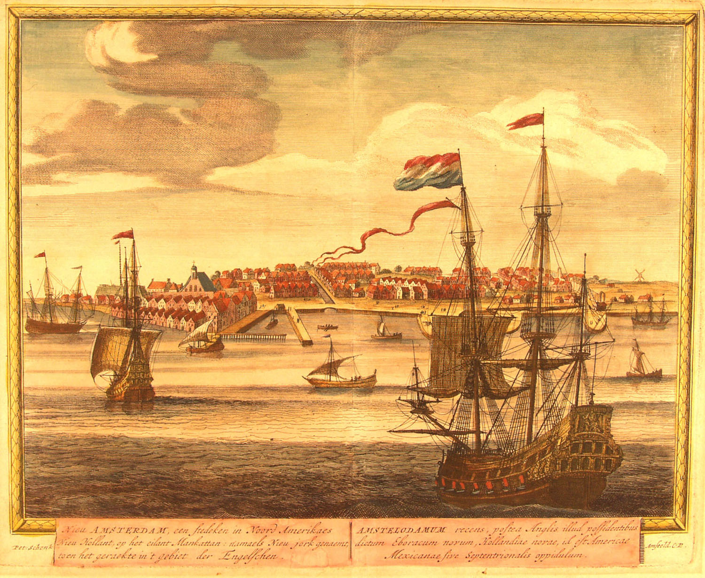
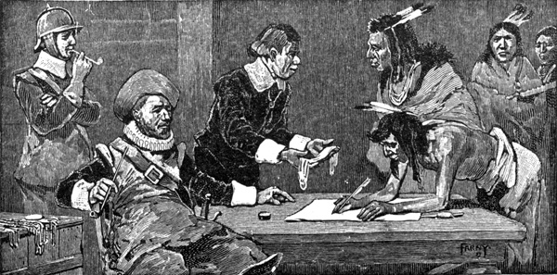
Use these documents to guess what the Dutch colonies in North America were like

Slide 30
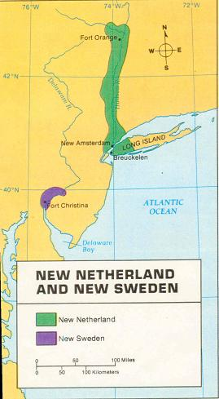
Dutch Colonies in North America

Slide 31
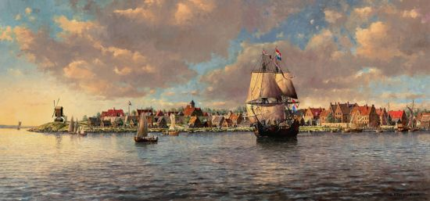
The Dutch founded New Netherland a colony in present-day New York City in 1625 & called the city New Amsterdam.
New Amsterdam was created by private investors of a joint-stock company who hoped to profit from trade in America
Why did the Dutch colonize in America?
To attract settlers, the Dutch gov’t allowed anyone, regardless of religion or nation, to immigrate & granted political freedom to their colonists…
...As a result, New Netherland was one of the most free & diverse colonies in America

Slide 32
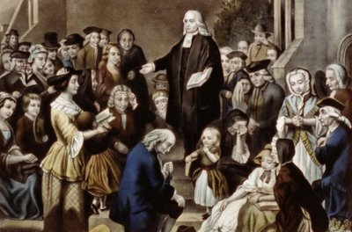
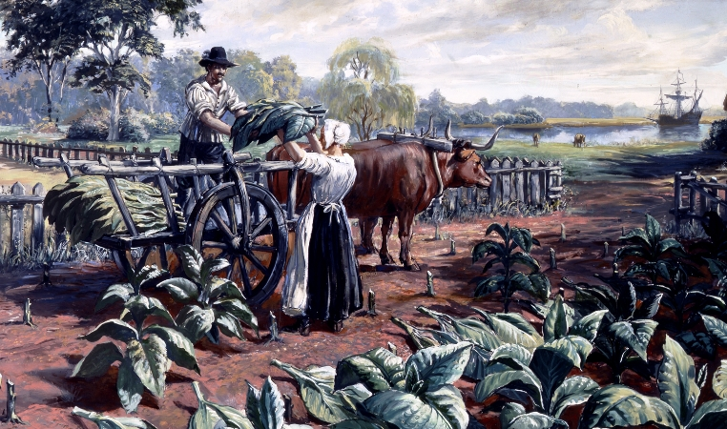
Use these documents to guess what the British colonies in North America were like

Slide 33
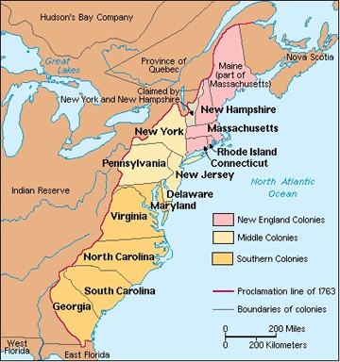
British Colonies in North America

Slide 34
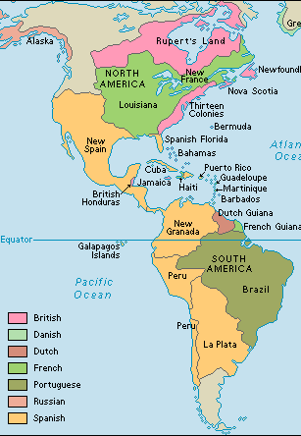
Like the Dutch, the British settled in America through joint-stock companies of private investors
British colonists came to America for a wide variety of reasons:

Slide 35
Like the Dutch, the British settled in America through joint-stock companies of private investors
British colonists came to America for a wide variety of reasons:
Some colonists came to America to escape poverty, gain wealth, or gain land
Some came for religious freedom & to flee religious persecution
Some colonists came to escape violence during the English Civil War

Slide 36
As a result, the British colonies were very different from each other & were never very unified

Slide 37
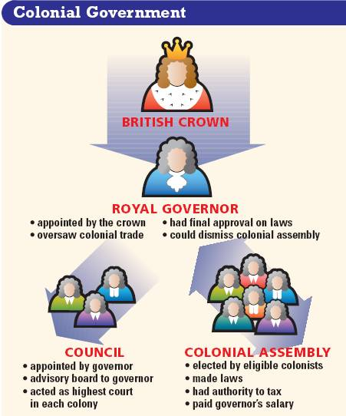
Britain developed a policy called salutary neglect that allowed colonists could create local laws & taxes in colonial assemblies…
…Royal governors were sent by the king, but they had little power

Slide 38
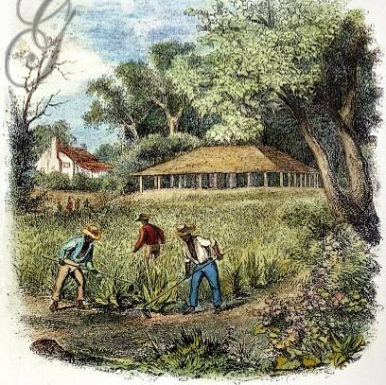
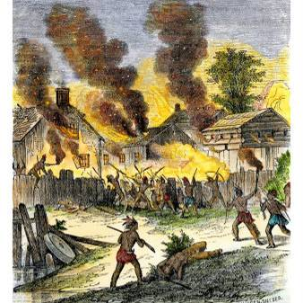
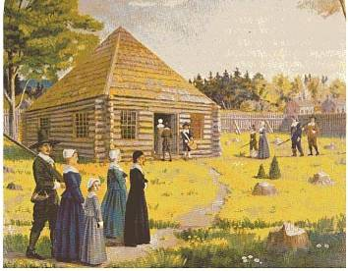
The societies & economies of the British colonies were dependent upon the reasons people settled
Unlike the Spanish & French, the British colonists never tried hard to convert, marry, or trade with local Indians, although conflicts over land were common
New England colonies, like Massachusetts, were closely connected by religion & families with an economy based largely on subsistence farming
Southern colonies, like Virginia, had cash crop economies, large gaps between rich & poor farmers, & slave labor

Slide 40
Review: Compare & Contrast
Compare and contrast the economic, political and cultural aspects of the early British & Dutch settlements.

Slide 41
Dutch Colonies in North America
Motivations:
The Dutch established New Amsterdam as a trade center
Political, Economic, Social:
To attract settlers, the gov’t allowed anyone to immigrate
As a result, New Amsterdam was one of the most diverse colonies in North America
Notes:
We’ll mention Peter Stuyvesant and the British takeover of the Dutch colonies during the discussion of the British Middle Colonies.

Slide 42
British Colonies in North America
Motivations: Many different reasons
Economic: Escape poverty or gain wealth from cash crop farming
Religious: For religious freedom & to escape religious persecution
Political: Fear during the English Civil War & Glorious Revolution
As a result, the British colonies were very different from each other & were not very unified in the beginning

