Slide 1
The Southern Colonies
The Carolina’s & Georgia

Slide 2
North Carolina
Farmers from Virginia established small, self-sufficient tobacco farms.
The region lacked good harbors which led to fewer large plantations.

Slide 3
South Carolina
With a warm climate and access to good ports, South Carolina’s plantation economy grew.
South Carolina became known for its large RICE plantations.

Slide 4
Georgia
Founded in 1732 Georgia was the last of the British colonies.
First colonists arrive in 1733 and settle along the Savannah River on Yamacraw Bluff.
Reasons for establishment:
Charity
Economics
Defense

Slide 5
The Middle Colonies
New York, New Jersey, Delaware & Pennsylvania

Slide 6
The Middle Colonies

Slide 7
Middle Colonies
Immigrants were attracted to the available land and a more tolerant religious atmosphere of the Middle Colonies.
This was in contrast to the New England Colonies, whose populations increased mainly through birthrate.

Slide 9
New York = New Amsterdam
New York was settled by the Dutch, who called it New Amsterdam
In 1664, the British conquered the colony from the Dutch and renamed it New York.

Slide 10
New York
NY became a center of trade & commerce (located on the Hudson River).
With members of various British & Dutch churches, New York tolerated different religions.

Slide 11
New Jersey
New Jersey enticed settlement with generous land offers and allowed for religious freedom and an assembly.

Slide 12
William Penn & Pennsylvania
William Penn was a Quaker and a champion for democracy and religious freedom.
He believed Pennsylvania was “The Holy Experiment” and wanted the colony to provide a refuge for Quakers and other persecuted people.
Penn advertised his colony in Europe to gain new settlers.

Slide 13
William Penn & Pennsylvania
His beliefs in treating people fairly extended to his business dealings with the Native Americans.
Pennsylvania territory grew through land purchases instead of wars and fighting for control of the territory.

Slide 14
Delaware
Originally part of Pennsylvania, Delaware was granted it’s own assembly by William Penn in 1702.

Slide 15
The Settlement of New England

Slide 17
New England
Many of the New England settlers were Puritans escaping from religious persecution in England.
The region’s northern location and poor farmland meant that its winters were cold and difficult.

Slide 18
Religious Persecution
The Puritans who settled in Massachusetts wanted freedom to worship as they pleased.
However, they required those who settled in their colony to follow Puritan theology.

Slide 19
Religious Persecution
Puritan religious dissenters (people who didn’t follow their faith) were banished from the Massachusetts colony.
Two members banished from Puritan Massachusetts were Roger Williams (founded R.I.) & Anne Hutchinson.
Rhode Island, Pennsylvania, & New Hampshire were settled as havens of religious freedom from the Puritans.

Slide 20
Religious Tensions
Church membership was on a decline in Puritan Massachusetts. To fix this they passed the half-way covenant.
The half-way covenant provided partial church membership for the children and grandchildren of original Puritans, regardless of their conversion experience.
They hoped that partial church membership would get them more involved and eventually encourage them to become full members of the church.

Slide 21
New England Government
The Mayflower Compact was the first attempt at self government. (Massachusetts)
In New England, they established an elected legislature.
They held town meetings where tax paying citizens met to discuss and vote on issues.
True Puritan power rested in the church leaders.

Slide 22
Paranoia hits Salem, Mass.
Claiming that they were possessed by the devil, several girls accused the towns people in Salem of being witches.
This event became known as the Salem Witch Trials
Salem Witch Trials Video Clip

Slide 23
The Salem Witch Trials
In a series of court hearings, over 150 Massachusetts colonists accused of witchcraft were tried.
29 of whom were convicted, & 19 were hanged.
At least 6 more died in prison.

Slide 24
Salem
The Puritans had created a theocracy in which the church could rule in civil matters, even sentencing someone to death for violations of church beliefs.
The magistrates used several methods, none of which would stand up in a court of law today, to determine the guilt or innocence of someone who was accused of witchcraft.

Slide 25
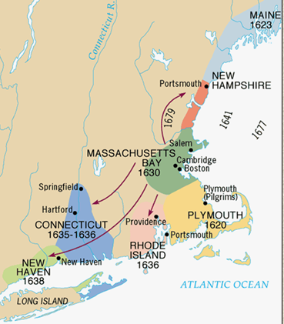
As the Massachusetts colony grew, it spawned four new colonies:
New Hampshire
Rhode Island
New Haven
Connecticut
Connecticut created the first written constitution in U.S. history called The Fundamental Orders of Connecticut

Slide 26
Relationship with Natives
At first relations were good.
A Treaty was signed between the Pilgrims and the Wampanoag Indians.
However, things will change…

Slide 27
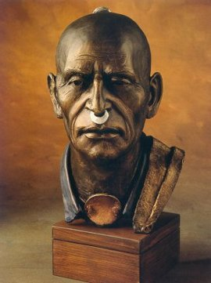
King Phillip’s War (1675-1676)
The only hope for Native Americans to resist white settlers encroachment on their land was to UNITE.
Metacom (King Phillip to white settlers) united the natives in his area and staged attacks on white settlements throughout New England.
Frontier settlers pushed back to Boston.

Slide 28
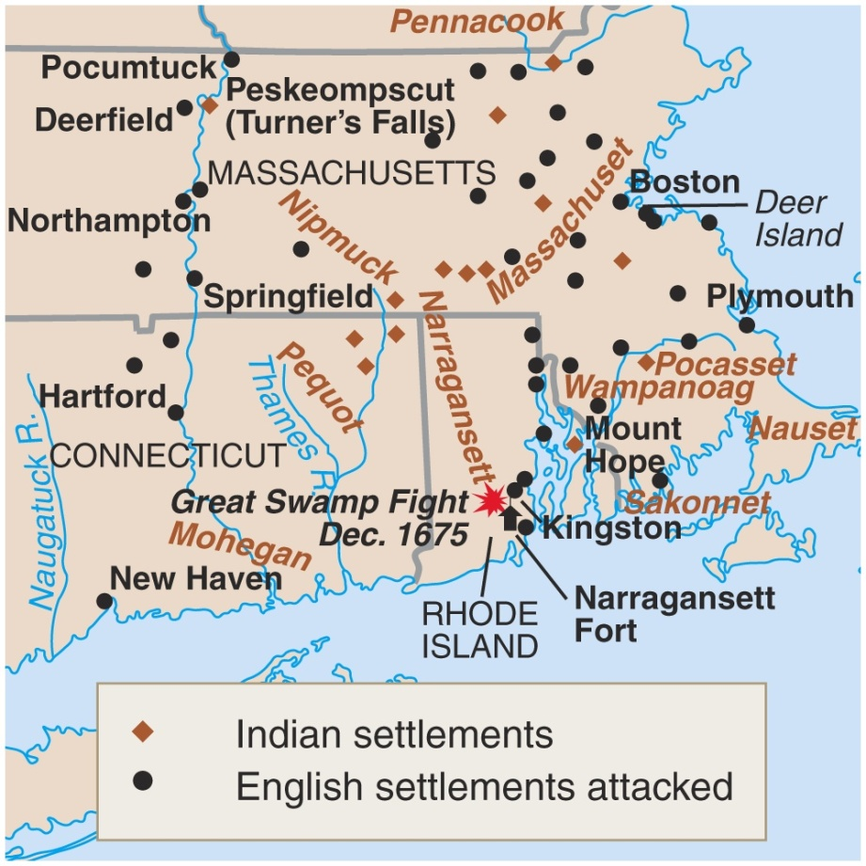
King Phillip’s War (1675-1676)
The war ended in failure for the natives.
Metacom beheaded
His son & wife were sold into slavery.
There was never a serious threat in New England again.

Slide 29
Massachusetts Bay
Massachusetts Bay began as a proprietary colony controlled by the Massachusetts Bay Company.
The colony had disagreements with England, however, mainly due to the Puritan clergy refusing rights to other religious groups such as Anglicans, Quakers, and Catholics.
In 1691, Massachusetts was chartered as a royal colony—a colony whose governor is appointed by the monarch.
This combined the Plymouth & Massachusetts Bay Colonies

Slide 30
Geography, Transportation, & Economy

Slide 31
13 English Colonies
Though the colonies were all English, the backgrounds and motives of the people who settled them were diverse.
Regional differences in both climate and natural resources guaranteed that each section would have a distinct culture.
It is no surprise that New England—composed of Puritan refugees trying to farm on difficult soil—would develop differently than Virginia—a proprietary-turned-royal colony suited to growing crops.

Slide 33
Climate & Geography
The northern and southern climates and geography influenced the types of crops grown.
Depending on the crop, different levels of labor were required.
Southern plantations became more dependent on slavery to make a profit from their crops.

Slide 34
Agriculture

Slide 35
New England
In the early days of colonial North America, New England was considered the poorest region.
This was due mostly to the cold climate and rocky soil.
Highest life expectancy in the colonies (Smaller population)
Highest literacy rate

Slide 36
Middle Colonies
Economic development (Agriculture or trade) of the Middle Colonies depended upon the geography and climate of the colony.
Some middle colonies resembled Southern Colonies, some resembled New England

Slide 37
Venn Diagram
Create a Venn Diagram comparing and contrasting the New England Colonies to the Southern Colonies.

Slide 38
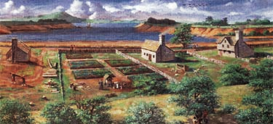
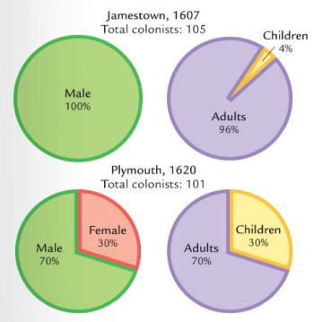
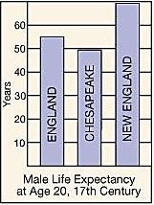
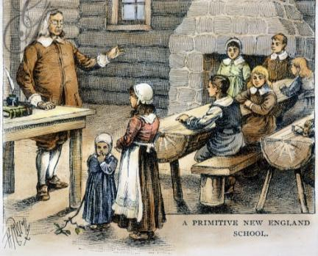
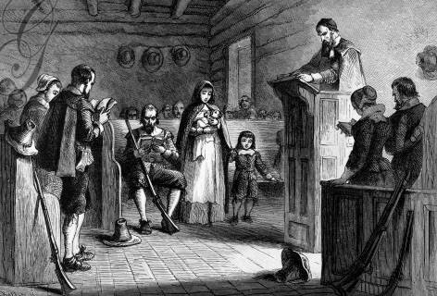
Quick discussion: Based on these images, how were the New England colonies different from Virginia?

Slide 39
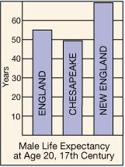
Massachusetts was a different colony from Virginia:
Puritans came to America for religious freedom
Puritan settlers usually came as families
Settlers sacrificed for the common good, built schools, & focused on subsistence farming
New England was a more healthy place to live than Virginia so colonists lived longer

Slide 40
Mercantilism
Philosophy of mercantilism:
there is only a set amount of wealth in the world
the only way for a country to obtain more wealth is to Export (sell) more than they Import (buy) which creates a “Favorable balance of trade”
Having colonies is important because they provide raw materials & markets.

Slide 41
Mercantilist System
Colonies exist as a market for England’s goods and a supplier of raw materials
All trade with other nations needs to go through the home-country.*
Mercantilism helped create trade patterns such as the triangular trade in the North Atlantic, in which raw materials were imported to the metropolis and then processed and redistributed to other colonies.
*Navigation Acts- All colonial trade must go thru England. English ships with English crews.

Slide 42
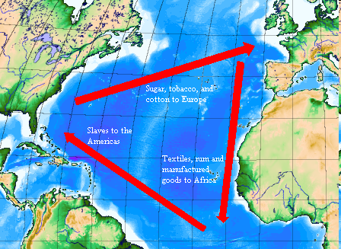
Triangular Trade
Middle
Passage

Slide 43
Triangular Trade
Trade between Europe, the Americas, and Africa was interdependent.
Europe traded manufactured goods with Africa in order to obtain slaves.
The slaves were then sent to North and South America to work on plantations in European colonies.
The crops grown in the Americas were sent to Europe where they were processed into manufactured goods.

Slide 44
The Atlantic Slave Trade

Slide 45
The Middle Passage
The Middle Passage was the middle leg of the triangular trade route and is the term used to describe the slaves' voyage across the Atlantic in ships.
The conditions on these trips were dangerous and horrendous.
Slave traders packed as many slaves as possible into ships and chained them together.
About 1 in 5 people died.

Slide 46
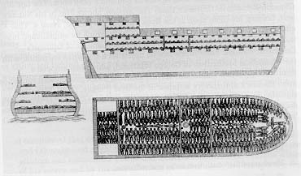
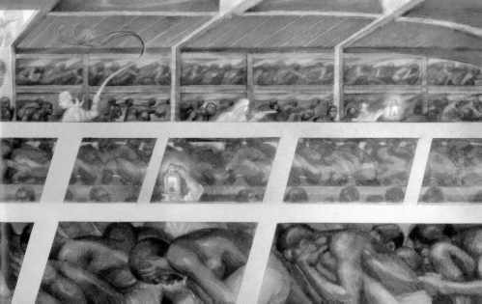
The Middle Passage

Slide 47
Growth of African population
By the mid-1680s, black slaves outnumbered white indentured servants.
As indentured servants became harder to obtain (and retain), demand for slaves increased (400,000) in colonies by 1776.

Slide 48
Growth of African population
Many slaves were used as labor on plantations throughout the Americas.
Sugar, cotton, and tobacco were all crops grown on plantations and then shipped to Europe

Slide 49
Early African – American Culture
Early African American culture developed as Africans were brought as slaves to North America.
The Africans kept many ideas and skills they had learned from their homeland
This blended with their experience as slaves to create a unique cultural identity.

Slide 50
African American culture grew in America
Slaves lived their lives under the worst of circumstances.
Slave communities were rich with music, dance, basket-weaving, and pottery-making.
Enslaved Africans brought with them the arts and crafts skills of their various cultures as well as advanced farming techniques.
Indeed, there could be a hundred slaves working on one farm and each slave might come from a different culture and a different part of Africa.

Slide 51
African Culture in America
New cultures started (Gullah)
Some desired freedom and revolted
NYC
Stono

Slide 52
Benjamin Franklin
Grew up modestly
Moved to Philadelphia at 17
Successful, writer, printer, scientist, philosopher, inventor, politician, diplomat
Retired at 42 and became public servant

Slide 53
Social Mobility
Benjamin Franklin believed that people had the right to make choices for themselves.
In 1700s, people could rarely change their social rank because they did not have enough money or education to rise above their current position.
Franklin was able to achieve social mobility by working hard and becoming involved in politics.
He is a symbol of social mobility because despite his humble childhood, Franklin became one of the most respected men in the United States.

Slide 54
Certainty? In this world nothing is certain but death and taxes. Benjamin Franklin A penny saved is a penny earned. Benjamin Franklin A place for everything, everything in its place. Benjamin Franklin Genius without education is like silver in the mine. Benjamin Franklin God helps those who help themselves. Benjamin Franklin

Slide 55
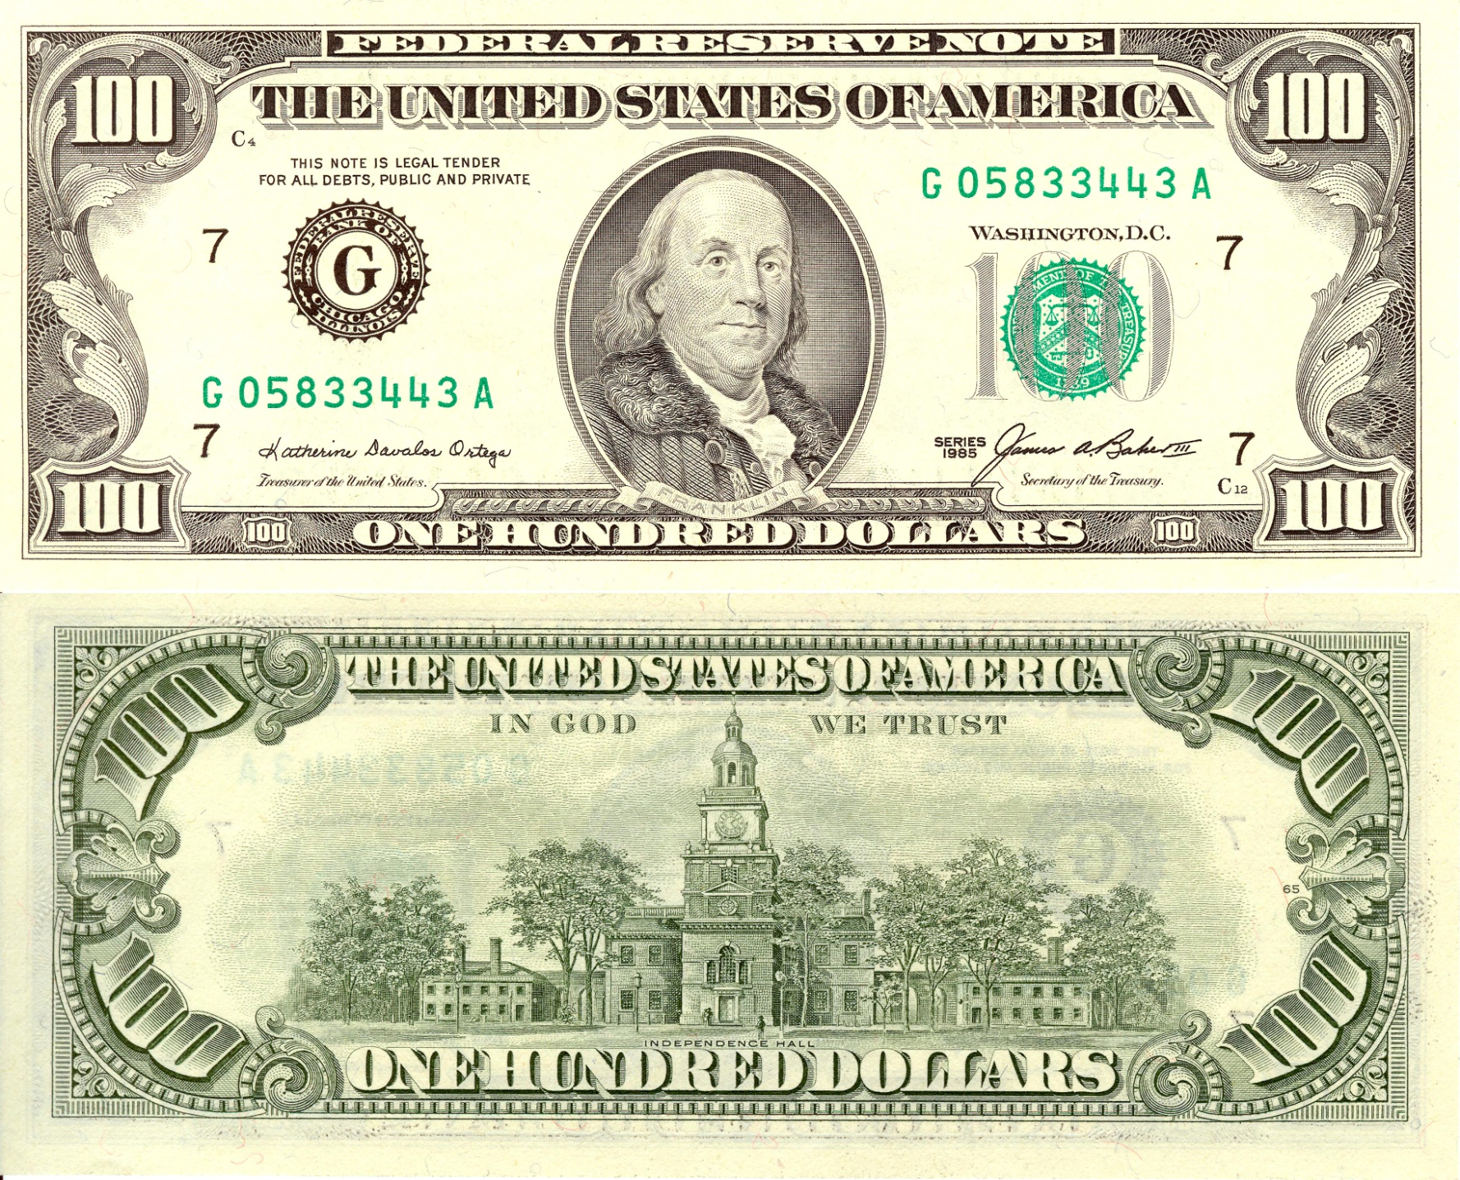

Slide 56
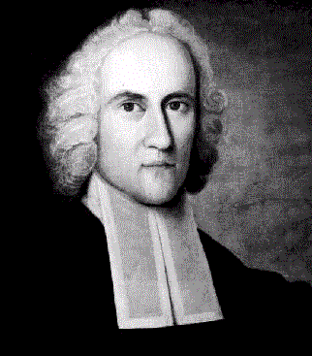
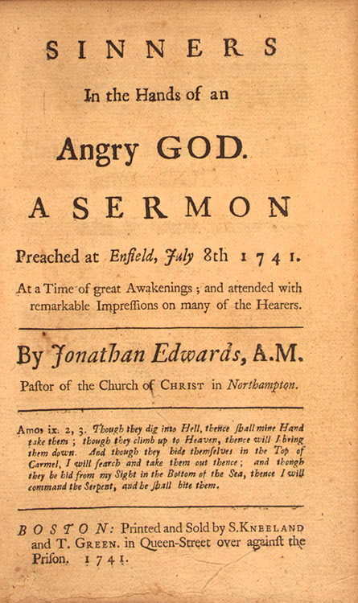
The Great Awakening (1730s – 1740s)
Religious zeal lessened
Calvinist beliefs weakened
Began in Mass under pastor Jonathan Edwards
No salvation through good works
Complete dependence on God’s grace
“Sinners in the Hands of an Angry God”
Hell was “paved with the skulls of unbaptized children”

Slide 57
The Great Awakening (1730s – 1740s)
George Whitefield
Tours county preaching message at revival meetings
“saved”
Inspires revival movement
Ministers divided
Old Lights – skeptical of emotionalism and theatrics of revivalists
New Lights – Awakening revitalized American religion
Congregationalists split

Slide 58
Effects of Awakening
Undermined old clergy
Increases number and competitiveness of denominations
New wave of missionary work with Indians and slaves
“new light” colleges
Princeton, Brown, Rutgers, Dartmouth
First spontaneous mass movement of American people ---Creates sense of united America

