Slide 1
SSUSH#5

Slide 2
Washington’s Accomplishments
1st President of the United States
Judicial Act of 1789 created the federal court system
Set up the Supreme Court
Federal Circuit Courts
Federal District Courts
Allowed state court decisions to be appealed to the federal level

Slide 3
Washington’s Accomplishments
Moved the Capital to Washington D.C. (1800)
Washington and Hamilton create the first Bank of the United States
War for Independence left many individuals, states, and local govt’s in debt
Bank handled the national debts
Created a uniform currency (money)

Slide 4
Washington’s Accomplishments
Washington creates 3 executive departments
The First Presidential Cabinet
Dept of State: Deals with Foreign affairs
Thomas Jefferson
Dept of War: Military
Henry Knox
Dept of Treasury: Gov’t Money
Alexander Hamilton

Slide 5
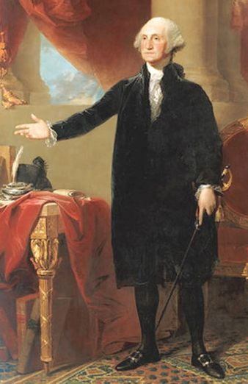
George
Washington
President

Slide 6
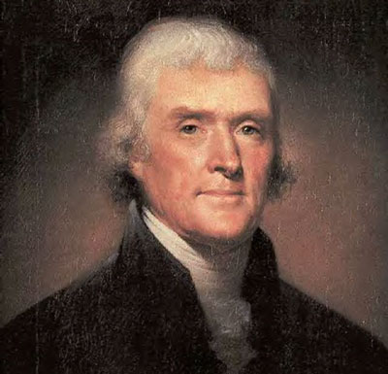
Thomas Jefferson
Dept of State

Slide 7
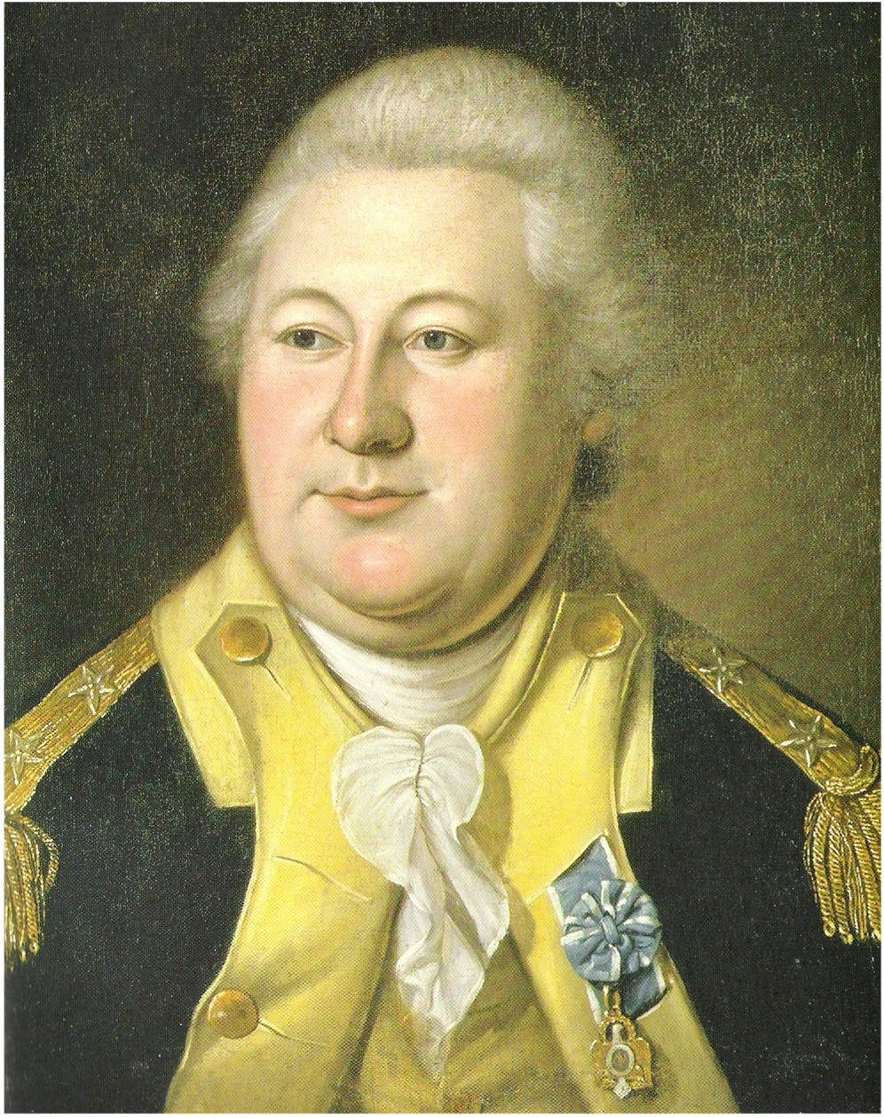
Henry Knox
Dept of War

Slide 8
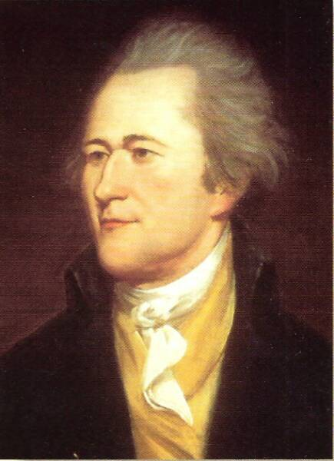
Alexander Hamilton
Dept of Treasury

Slide 9
Whiskey Rebellion
1789- Congress passed a protective tariff and a excise tax
Raises the price on imports so people buy American made stuff
Increased the price of whiskey dramatically in the states for consumers and producers
Whiskey producers rebel against the gov’t and are then “handled” by the army

Slide 10
The Whiskey Rebellion
1794 – poor farmers in Western Pennsylvania revolt against excise tax on whiskey
Liquor often used as money
Argued they were unfairly singled out
Calls of “taxation without representation”
Washington calls out army of 13000 troops
Rebels scatter
Proves gov. now strong enough to withstand internal threats

Slide 11
Washington’s Legacy & Farewell Address
Benefits of a strong federal gov’t
Warns against the party system
Stresses the importance of religion and morality
Warns against permanent foreign alliances
Avoid an over powerful military

Slide 12
Political Party Hostilities
Federalist become the Federalist Party
favor Strong Central Gov’t
Hamilton was a Federalist
Anti-Federalists become the Democratic Republicans
favor states rights
Jefferson was a Democratic Republican

Slide 13
Political Party Hostilities
Federalists pass the Alien and Sedition Acts
Alien Act: allowed the gov’t to arrest and detain foreigners
Sedition Act: limited free speech
Nullification: States can ignore any law they “think” is unconstitutional
Election of 1800 turns power of the gov’t over to the Democratic Republicans
Thomas Jefferson vs. John Adams

